Slide 1
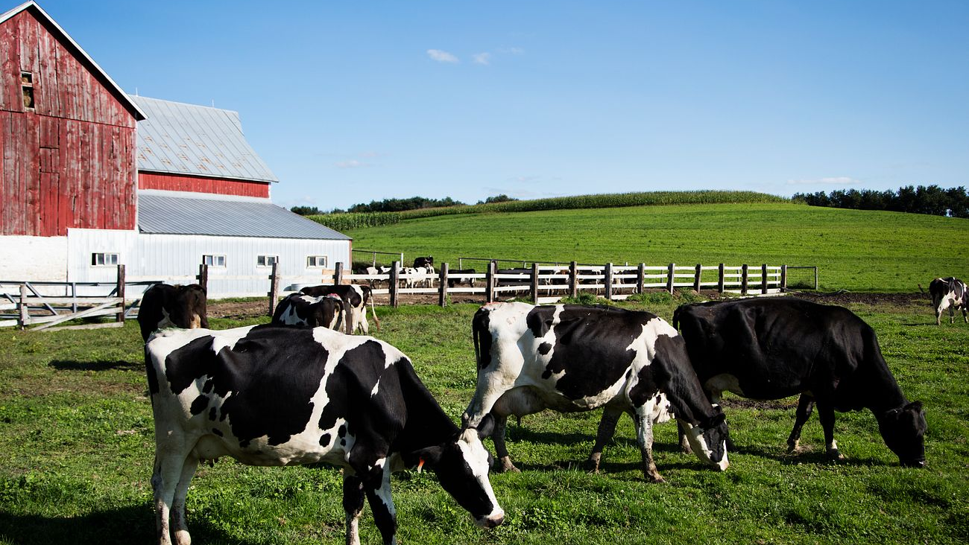
Dairy Farm case study
Presented By:
Abhinav Agarwal
Ujwal Geed
Bharath Reddy
Raju Tejavath

Slide 2
Overview and challenges of dairy farm group’s
The Dairy Farm Group's Singapore Supermarkets and Hypermarkets division has encountered poor sales performance.
Despite maintaining market share, Dairy Farm Group faced challenges in 2016 and 2017 due to lower sales in its Singapore supermarket business, attributed to store rationalization and intensified competition from discount retailers and e-commerce players.
Geographic footprint: Operations across Asia with notable presence in Southeast Asia
To address challenges, Dairy Farm Group must align operations with market dynamics, innovate in product offerings, and strengthen its competitive position in Singapore's retail landscape.

Slide 3

Dairy farm group customers Who are Dairy Farm Group’s customers? Where do Dairy Farm Group’s customers reside based on each of its brands? What is the profile of its customers for each of its brands? Are the customer profiles different for each brand?

Slide 4
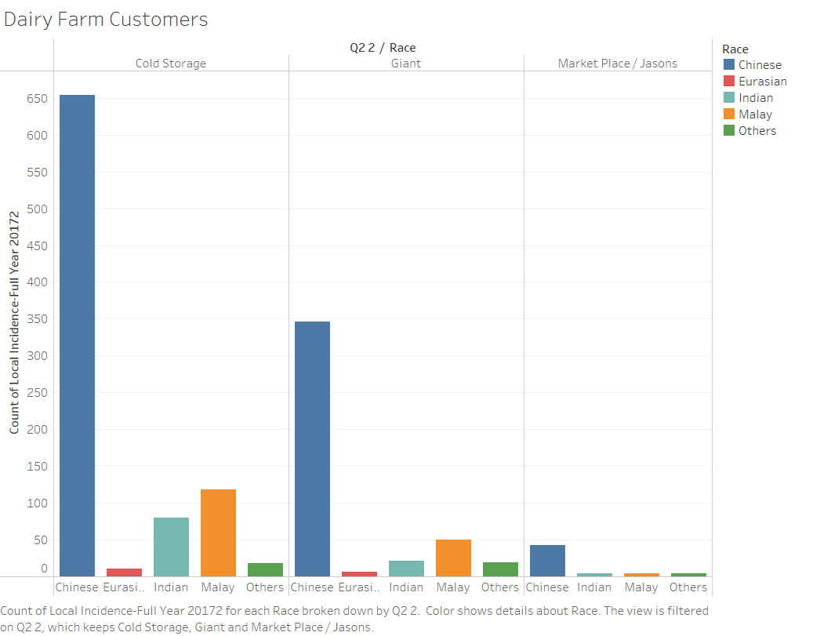
Dairy farm group’s customers
Taking race into consideration, it's observed that Chinese and Malay customers constitute the majority of Dairy Farm's customer base, closely followed by Indian customers.
Dairy farm group’s customers by Race

Slide 5
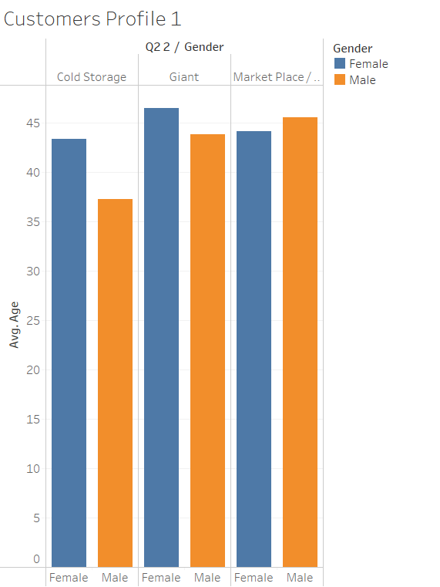
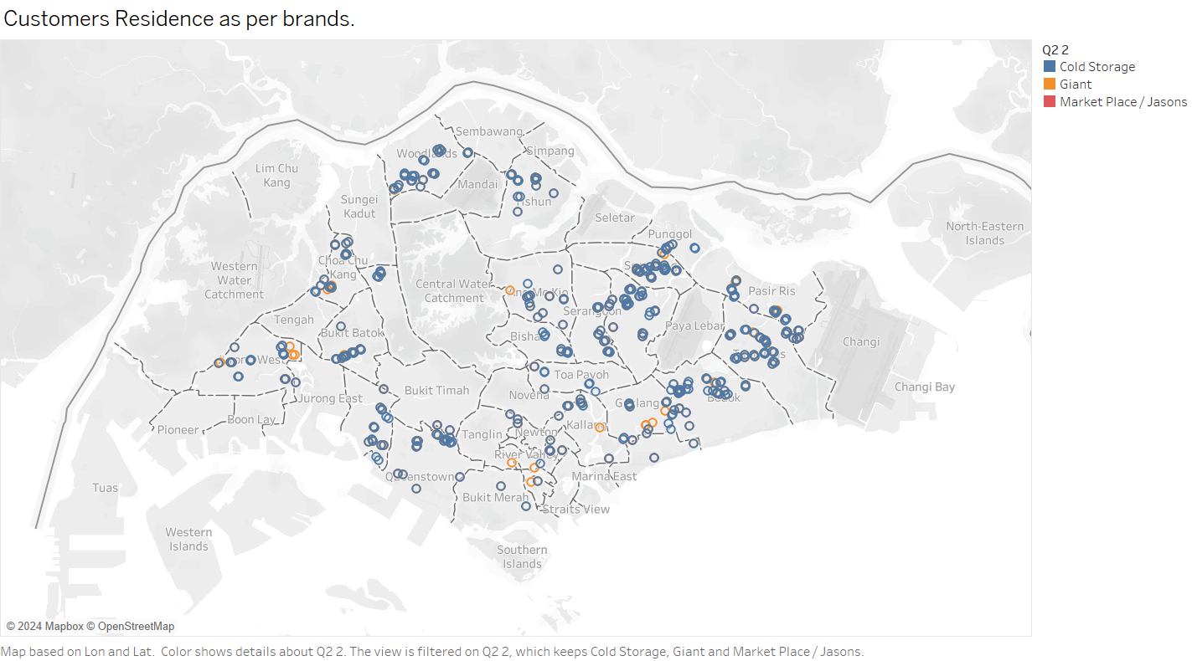
Geographic distribution of dairy farm group’s customers
The average age of dairy farm’s customers fall in the range of 40 to 45.
Cold storage have the more customer than other competitors in Singapore.
Dairy farm group’s customers as Gender
Dairy farm group’s customers residence as per brands

Slide 6
Customers profile by brand
Profile of customers is different by each brand as given below
Cold Storage
Target Segment: Premium shoppers prioritizing quality and variety.
Demographic Characteristics: Higher income individuals, expatriates, and professionals.
Psychographic Characteristics: Quality-conscious, willing to pay premium for fresh produce and organic products, prefer international brands.

Slide 7
Customers profile by brand
Giant
Target Segment: Family-oriented and budget-conscious customers.
Demographic Characteristics: Diverse age groups, primarily families seeking value.
Psychographic Characteristics: Price-sensitive, prioritize affordability without sacrificing quality.

Slide 8
Customers profile by brand
Marketplace/ Jason
Target Segment: Discerning customers seeking gourmet groceries and fine wines.
Demographic Characteristics: Affluent individuals with a preference for luxury or niche market products.
Psychographic Characteristics: Expect high-quality customer service, products, and an exclusive shopping experience.

Slide 9

Competitor’s and their customer’s Who are Dairy Farm Group’s competitors? Which customers are its competitors currently serving? What is the customer profile for each of its competitors?

Slide 10
Dairy farm group’s top 3 competitors
Targets budget-conscious shoppers and families, providing affordable groceries and household essentials.
Appeals to a broad customer base with the aim of stabilizing prices and ensuring accessibility for all income levels across Singapore.
NTUC FairPrice
Caters to cost-conscious consumers, particularly in heartland areas, offering value-for-money food and everyday necessities.
Focuses on budget-conscious customers, providing a range of affordable products, including fresh produce, live seafood, and meat.
Sheng Siong
Online platforms offering a variety of products traditionally sold in supermarkets.
Increasing competition for brick-and-mortar stores, prompting supermarkets to establish online stores to provide alternative shopping channels for customers.
Prime Mart

Slide 11
Customer’s profile of competitors
NTUC FairPrice
Targets frugal shoppers and families by offering economical groceries and household essentials.
Aims to cater to a wide range of consumers, ensuring affordability and accessibility across Singapore.
Implements various promotional strategies and discount programs to attract and retain customers.
Sheng Siong
Focuses on budget-conscious shoppers, particularly in residential areas, providing affordable groceries and daily necessities.
Emphasizes affordability and value for money, featuring a diverse selection including fresh produce and meats.
Prioritizes customer satisfaction with extended store hours and convenient locations for enhanced convenience
Prime Mart
Online platforms providing a plethora of items traditionally available in brick-and-mortar stores.
Intensifies competition in the retail sector, prompting traditional outlets to establish digital storefronts to accommodate shifting consumer preferences.
Leverages advanced technology and logistics for seamless delivery options and personalized shopping experiences.

Slide 12

Investment in new stores in the northern region Is there a difference between where Dairy Farm Group stores are located and where its customers reside? Given the current distribution of stores (see Store locations excel file), should Diary Farm Group open more new stores in the northern region?

Slide 13
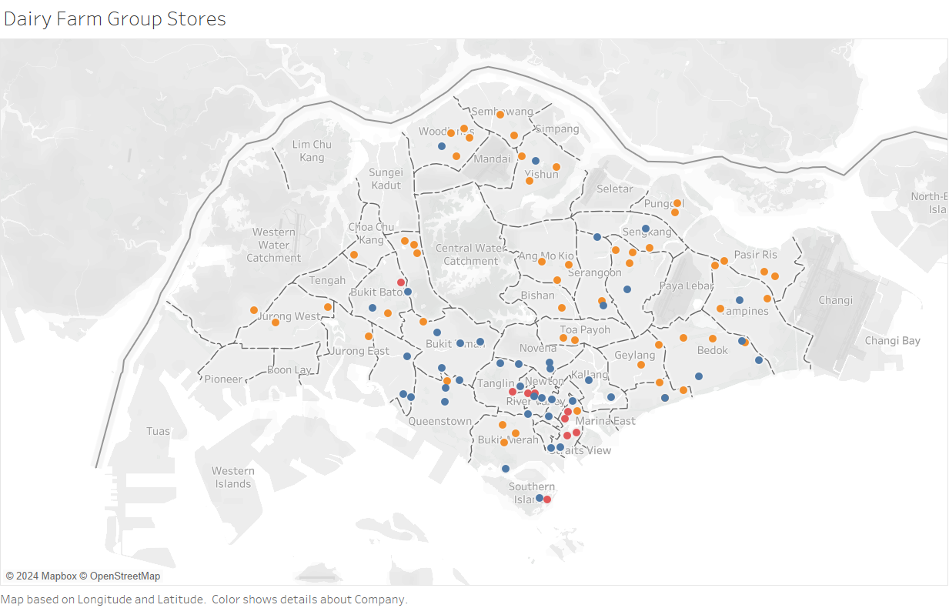
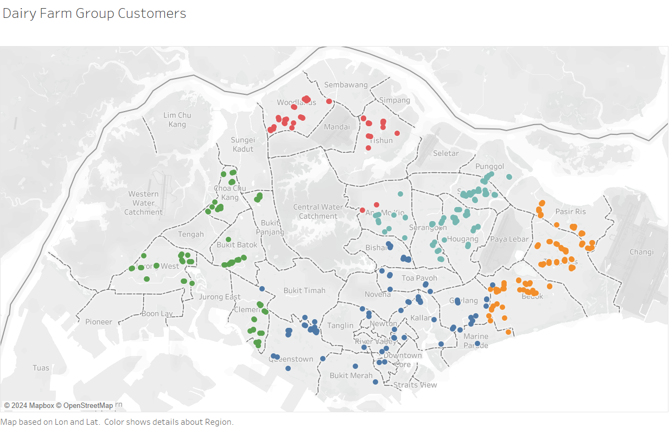
difference between where Dairy Farm Group stores are located and its customers reside
Dairy farm group stores
Dairy farm group customers

Slide 14
should Diary Farm Group open more new stores in the northern region?
Yes, The northern region of Singapore presents a potential opportunity for Dairy Farm Group due to:
Market Potential:
Initial analysis reveals that this region is currently underserved compared to competitors such as Sheng Siong, particularly in heartland areas.
There is a noticeable gap in the availability of retail options, indicating potential for Dairy Farm Group to fill this void.
Limited competition suggests an opportunity to establish a strong foothold and capture market share in the northern region.

Slide 15
2. Demographic Shifts:
Population growth and changing consumer preferences in the northern region indicate a growing demand for a wider range of retail options.
Increasing urbanization and lifestyle changes are driving demand for convenience and variety in shopping experiences.
Emerging affluent segments within the demographic landscape present an opportunity for Dairy Farm Group to cater to diverse consumer needs.
3. Competitive Landscape:
Despite the presence of budget-focused competitors like Sheng Siong, there is potential for Dairy Farm Group's distinct brands to attract a portion of the market share.
Differentiated offerings and unique value propositions can help Dairy Farm Group carve out a niche and establish brand loyalty among consumers.
Leveraging strengths such as product diversity, quality, and service excellence can position Dairy Farm Group as a preferred choice in the northern region.

Slide 16

Strategic Recommendation and conclusion

Slide 17


Strategic recommendation
Optimize The store Location
Conduct a thorough analysis to identify areas with high customer density and potential demand.
Strategically relocate or open new stores in underserved areas, particularly in the northern region of Singapore, to better align with customer residences and preferences.
Embrace Digital Transformation
Expand and improve e-commerce capabilities to capture the growing demand for online shopping.
Implement an omnichannel approach to provide seamless shopping experiences across online and offline channels, enhancing convenience and accessibility for customers.

Slide 18


Customer Engagement and Loyalty
Implement customer segmentation strategies to better understand and address the diverse needs of different customer segments.
Develop personalized marketing campaigns and loyalty programs to foster customer engagement and enhance brand loyalty.
Product Diversification
Tailor product offerings to align with local preferences and consumer trends.
Introduce exclusive products or unique variations to differentiate Dairy Farm Group's offerings from competitors and enhance the overall value proposition for customers.

Slide 19
Conclusion
Competition from established players and e-commerce platforms is intense, requiring ongoing innovation.
Mismatch between store locations and customer residences, especially in the northern region, suggests expansion opportunities.
Strategic recommendations include optimizing store locations, enhancing brand differentiation, embracing e-commerce, fostering customer engagement, and staying agile.
Implementing these recommendations will bolster Dairy Farm Group's competitiveness and facilitate sustainable growth in the retail market.

Slide 20

Thank you

